Slide 1

Superintendent’s State of the Schools
Metropolitan School District of North Posey
January 9, 2023

Slide 2
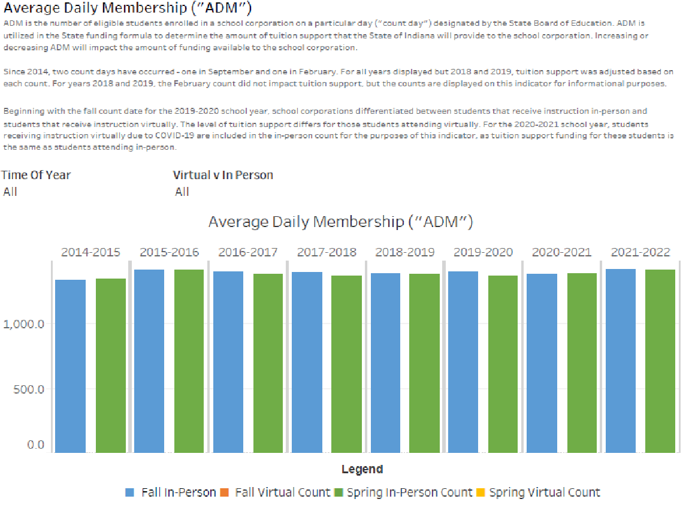
Average Daily Membership

Slide 3
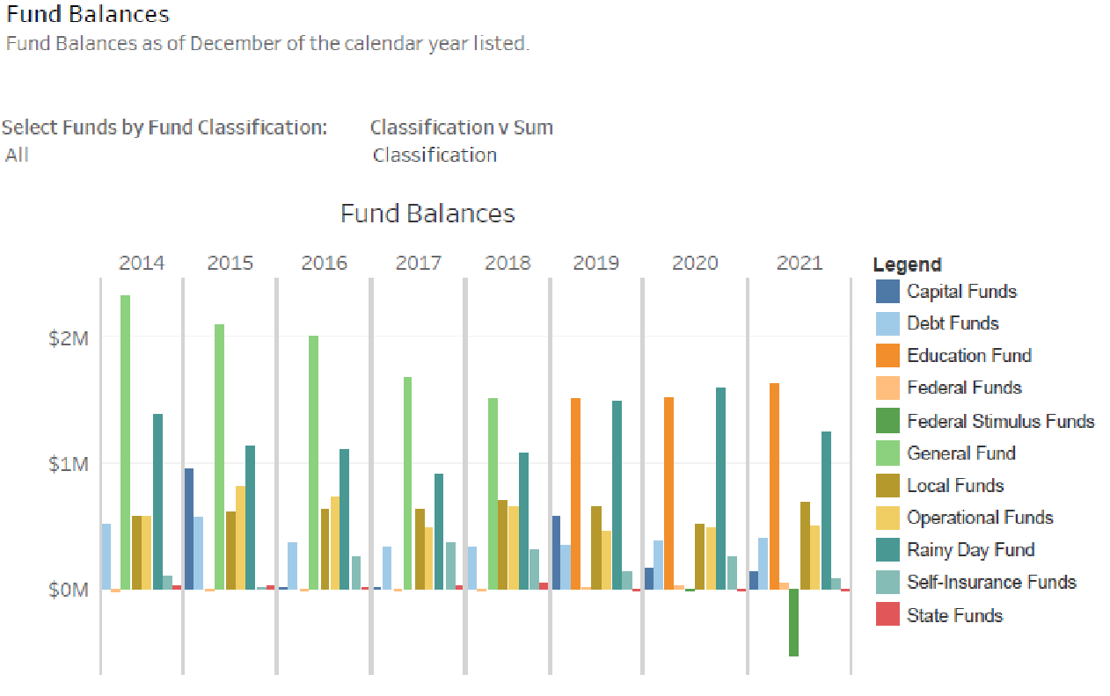
Fund Balances for the District

Slide 4
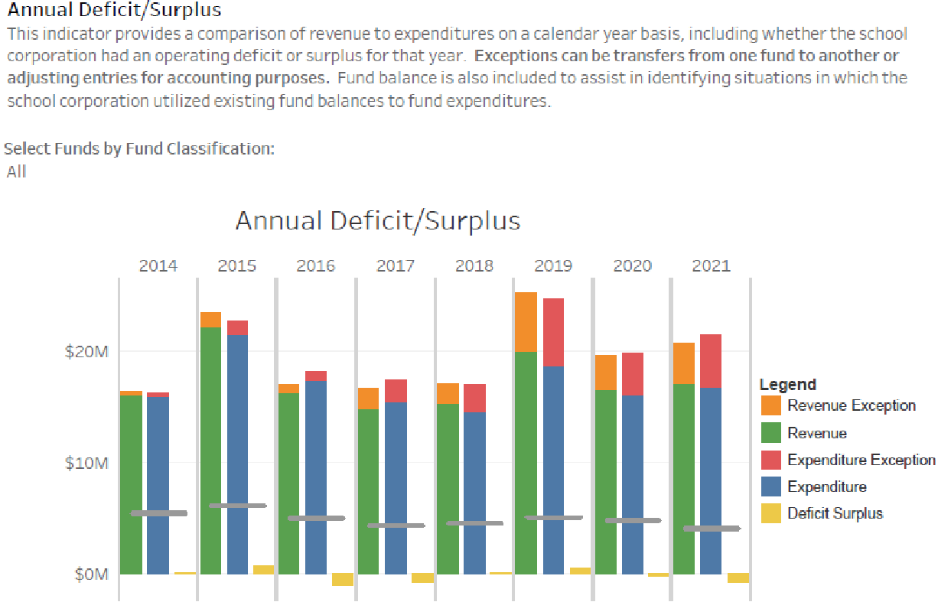
Annual Deficit/Surplus

Slide 5
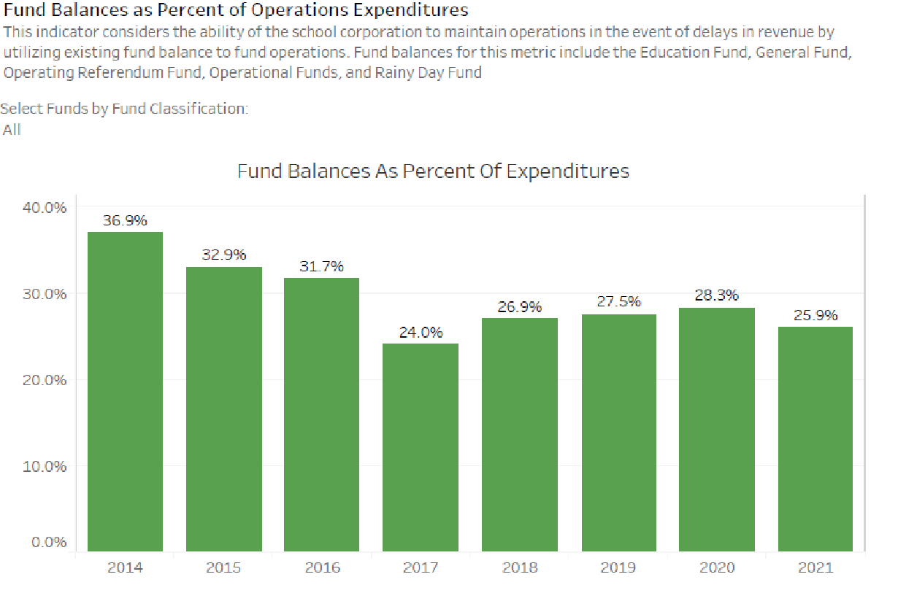
Fund Balances as Percent of Expenditures

Slide 6
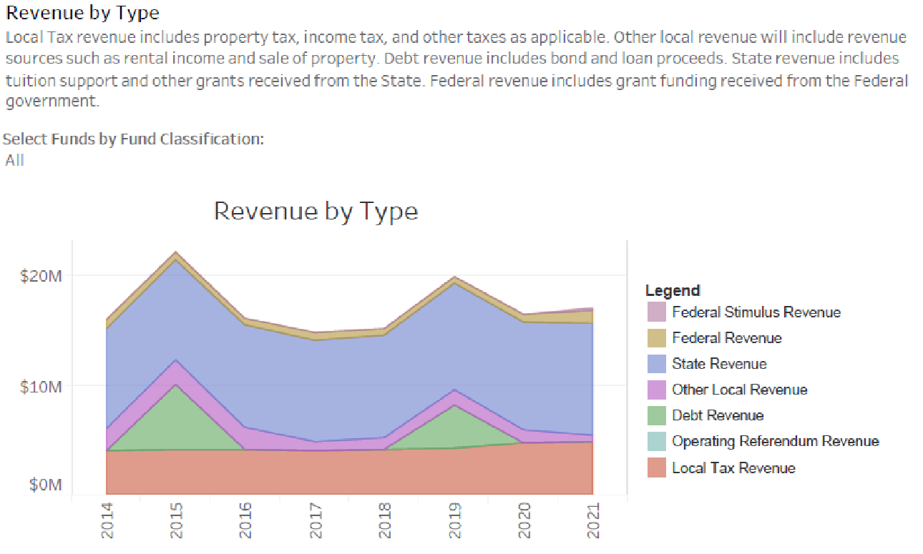
Revenue by Type

Slide 7
2022-2023 Demographics
Enrollment:
  September 16: 1389.24
  Current: 1379
Free and Reduced Lunch: 28.2%
Special Education Population: 18.2%
English Language Learners: 0.1%
Number of Certified Staff: 100
  79% Highly Effective
  19% Effective
Number of Classified Staff: 125

Slide 8
Current Financial Health
Education Fund Balance: $1,880,275.50
Operations’ Fund Balance: $1,086,638.89
Rainy Day Fund Balance: $1,244,452.85
Per Pupil Expenditure
  2020: $8,593.88 (Indiana $9,193.68)
  2019: $8,535.94
2023 Budget
  Assessed Values:
    2023 Assessed Value: $584,037,526
      Increase: $95,436,615
    2022 Assessed Value: $488,600,911
    2021 Assessed Value: $484,868,940
  Rates:
    2023 Rate: 0.9691
    2022 Rate: 0.9337
    2021 Rate: 0.9273

Slide 9
Current Financial Health
  Levy:
    2023: $5,576,530
      Difference: $1,085,832
    2022: $4,490,698
    2021: $4,417,689
Debt:
  2010 Bond: $1,489,000; Payoff: 2024
  2015 Bond: $5,507,000; Payoff: 2033
  2019 Bond: $9,998,000; Payoff: 2038
  2022 General Obligation Bond: $1,518,918.65; Payoff: 2024
Additional Funding:
    ESSER I, ESSER II, and ESSER III

Slide 10
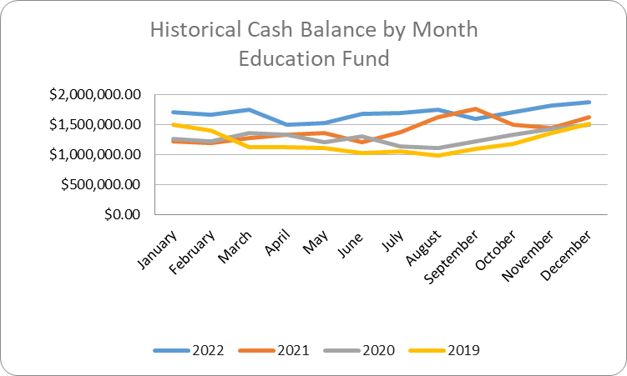
Education Fund Historical Cash Balance

Slide 11
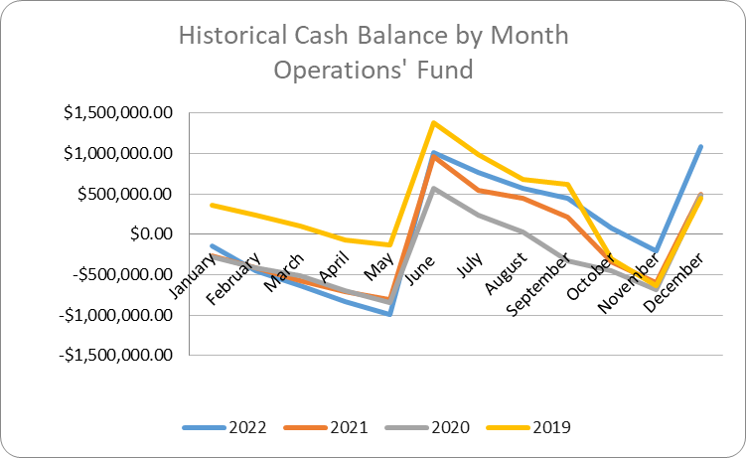
Operations’ Fund Historical Cash Balance

Slide 12
Challenges and Opportunities for Education Fund
Challenges
  Sustainability of ESSER Funded Projects
    Elementary Counselor
    Career and Technical Education Coordinator
    Preschool Teachers
  Enrollment
  Cost of Qualified Candidates
  Salary Schedule Inconsistencies
  Rising costs of benefits
  Ongoing Transfers to the Operations’ Fund – 15%
Opportunities
  Grant Opportunities to Support Instructional Programming
  State Revenue and Budget: Proposed 6% Increase

Slide 13
Challenges and Opportunities for Operations’ Fund
Challenges
  Age of Facilities
  Remodel of Special Education Classroom
  Electrical and Natural Gas Expenses
Opportunities
  General Obligation Bond
  Grant Opportunities – Department of Energy

Slide 14
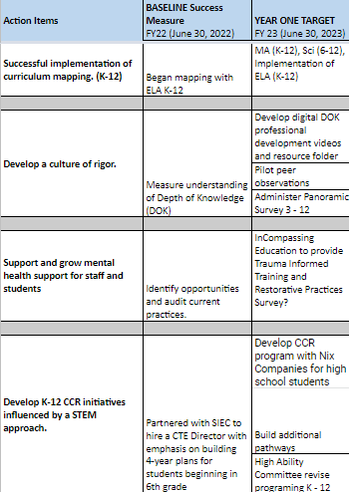
Goal #1: We will create a dynamic and innovative educational experience driven by a whole-student approach.

Slide 15
Goal #1: We will create a dynamic and innovative educational experience driven by a whole-student approach.
Curriculum Mapping Progress Update
  JH/HS mapped math curriculum first semester
  ELA curriculum maps implemented since the start of the school year.
  Elementary mapping math second semester
Culture of Rigor
  Committee developed Depth of Knowledge folders to share with district
  Continue to build resources for staff

Slide 16
Goal #1: We will create a dynamic and innovative educational experience driven by a whole-student approach.
SEL for staff and students
  SEL PD through Incompassing Education
  Incompassing Education provide restorative practices survey
K - 12 CCR Initiatives
  High School continues to work with Nix to develop CCR program
  Process to apply for Early College Credentials has started.
  High ability teachers provided with PD this year to assist with revision of curriculum

Slide 17
Goal #2: We will inspire a culture of investing in our professionals to impact learning and innovation.
 | FY22 (June 30, 2022) | FY 23 (June 30, 2023)
We will build leadership capacity across the district | Develop a current list of leadership opportunities | Assess and define current leadership opportunities across the district
 |  | Develop policies and procedures surrounding committee selection.
Success Measures
Develop a culture of Learning | Hrs.Committed to PD: 10 hrs ___________________________________ Amount spent on PD: $60,000 ___________________________________ Use 21-22 PD survey response, School Improvement Plans, Student Achievement Data | Develop a PD calendar (offer on website) and way for teacher to communicate areas of interest/need
 |  | INcompassing Education - present 3 session introduction to SEL: Assess and develop Professional Learning Communities
 |  | Develop new learning opportunities *(peer observations, teacher/admin swaps, conferences, etc.)
Success Measures

Slide 18
Goal #2: We will inspire a culture of investing in our professionals to impact learning and innovation.
 | FY22 (June 30, 2022) | FY 23 (June 30, 2023)
Attract and retain high quality candidates | Conduct audit of current staffing: Total staff, % highly qualified teachers, dual credentialed teachers, total years of experiences (by building), % of new hires with 1 or more years of experience, % of new teachers participating in mentorship program, # of mentor teachers, Climate and culture survey data, # of employee appreciation events. | Assess and develop teacher cadet program
 |  | Staff retention will be 95% (exceeds expectations, 90% (meets expectations), and less than 90% (needs improvement)
 |  | Participate in the 3E grant to build a teacher education pathway
Success Measures: Set goals surrounding retention, increase of degrees, and students graduating with desire to enter educational field

Slide 19
Goal #2: We will inspire a culture of investing in our professionals to impact learning and innovation.
Current Progress - Build Leadership capacity across the District and Develop a Culture of Learning
Create North Posey version of C.P.U. (Connected Pursuits University)
  This program is based on the PD model currently being implemented at Crown Point HS
  Can be easily altered to meet the needs of our entire district
Create Professional Learning groups that represent the entire district (New/Veteran teachers, Elem/Middle/High School teachers, variety of subjects, etc.)
PD Groups:
  Groups would be led by the principals as well as teacher leaders
  Groups would meet for 30 minutes one time per month
  All groups would cover the same topic and complete same activities

Slide 20
Goal #2: We will inspire a culture of investing in our professionals to impact learning and innovation.
Current Progress - Build Leadership capacity across the District and Develop a Culture of Learning
4. PD committee will meet throughout this semester to create a monthly calendar of topics. Example:
August - connectivity within the classroom
September - Rigor - What does it look like? How do I incorporate it in my classroom?
October - Student Apathy - How do I combat it in my classroom? My school? My district?
The Goal - Create a Professional Development plan that is relevant to all teachers within our district. A plan that allows our teachers to work with, learn from and support their colleagues. A plan that allows administration to support and build the leadership abilities of our teachers while also working to meet the needs of all teachers across our district. Most importantly, create a plan that equips teachers and administration to better serve the needs of all North Posey students from grades K-12.

Slide 21
Goal #3: We will embrace community involvement for engagement in district successes
 | FY22 (June 30, 2022) | FY 23 (June 30, 2023)
We will increase student opportunities in the community | Audit of community partnerships. Who, what, when, and how for each partnership. | TBD increase of partnerships
 | Audit current service projects, build goals to inform plan. | Develop implementation plan to build a culture of service across the District.
 |  | Build community internship model.
Success Measures |  | Development of Opportunity Magazine
Promote the District to our community | Audit current communications and marketing strategies. | Develop a communications and marketing plan.
 |  | Hire marketing/communications intern to begin to implement plan.
 |  | Develop a master list of building level activities for community engagement.
Success Measures |  | Distribution of 2-3 flyers to the community
 |  | Develop 9 teacher focus videos for marketing

Slide 22
Goal #3: We will embrace community involvement for engagement in district successes
Current Community Partners - Result of Survey
Junior Achievement
Relay for Life
Riley Children’s Hospital
Kids Caring and Sharing
Posey Co. Soil and Water
Posey Co. Extension
Hoosier Salon Art Gallery
Evansville Museum
Holly’s House
Habitat for Humanity
Tri-State Food Bank
Department of Child Services
Ireland Home Based Services
Pearison Inc.
Honor Flight of Southern Indiana
American Red Cross
Countrymark Co-Op
Expressway Automotive Family
Nix Companies
Bradley Stevens, Inc.
Curtis Maruyasu America, Inc.
MAGIC after school program
Poseyville Masonic Lodge
Ronald McDonald House
Tobacco Free Posey County
Posey County Sheriff
Indiana State Police
Posey EMS / Local Fire Departments
Albion Fellows Bacon Center
RGRG
Big Brothers Big Sisters
Ivy Tech Community College
University of Southern Indiana
University of Evansville
Kiwanis Poseyville
STEM / Career Fair Business Partners
Hirsch’s Grocery Store
Harmonie State Park
PEERS

Slide 23
Goal #3: We will embrace community involvement for engagement in district successes
Current Progress - Marketing
Marketing consultant hired by district beginning Fall, 2022 - Casey Voelker
District employee of the month program established - Fall, 2022
Steps taken to align branding consistency throughout the district
  Standardization of logos
  New district Facebook page
Enhanced website - District and School levels through Mambo schools

Slide 24
Goal #3: We will embrace community involvement for engagement in district successes
Current Progress - Community Engagement
Grandparents’ night (ST and NE)
  improved advertisement
  Food
  Bingo
2nd Annual Fall Homecoming Parade
  Continued success and development
Trunk or Treat (ST)
1st Annual Parents’ Night Out
  Sophomore class fundraiser
1st Annual Spirit of Christmas Toy Drive and Santa visits
  Christmas tree representing each school and district
  Ornament activity of each school
High school “Cookies and Ornaments” activity after school event
Food Drive
  HS and Jr HS Student Councils
College Counseling Night
  Community outreach event sponsored by NPHS Academics
Candy Cane Market (NE)
Veterans’ Day Programs
Family Fun Night
  North Elementary Spring event

Slide 25
Goal #4: We will responsibly manage our budget, operations, and enrollment.
Progress Update
Increase Cash Balance of Education Fund by 2%.
  January 1, 2022: $1,624,687.23
  January 1, 2023: $1,880,274.58
  Increase of 13.6%
Future Plans
Meet with PR to determine format for financial communication tool.
Develop a tool to tag budgetary expenditures to strategic plan.

Slide 26
Superintendent’s State of the Schools
Metropolitan School District of North Posey
January 9, 2023

